Slide 1
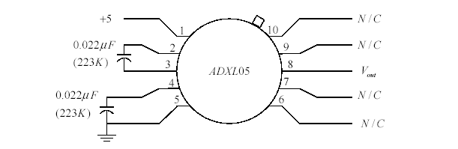
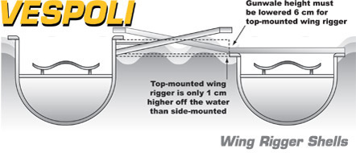
Trial 1 – Unsuccessful - Tilt Sensor
In order to measure tilt of the boat, we are going to use an ADXL05 Accelerometer. The accelerometer works by measuring
the acceleration due to gravity in a certain plane. If that plane is tilted, the output of the accelerometer will be proportional
to the portion of the gravitational acceleration field vector in the direction of the reference frame. As the tilt occurs, the
gravitational acceleration in the reference frame will decrease either positively or negatively. Using this linear relationship,
a measurement of tilt as well as direction can be calculated. Using a scale and shift circuit, this output voltage can be
sent to our virtual coxswain to aid in the balancing of the boat.
Reference Plane
ENCL-5

